Slide 1

KALERWE
S.D.A Hymnal 341
3 ~ Verses
3.
Aweebwe Ekitiibwa…
~
To God be The Glory…

Slide 2


1 of 3 verses
Aweebw(e) ekitiibwa Katonda waffe; Yayagal(a)Ensi n’awaay(o)Omwana we
Yafuuka Saddaaka Y’ekibi kyaffe;
Naggulaw(o) oluggi ffe tuyingire

Slide 3
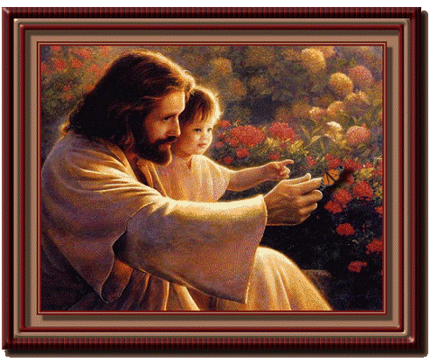
1 of 3 verses
CHORUS:
Tumutendereze, Ensi ewulire;
Tuyimbe tuyimbe, Ensi Esanyuke;
Mujj(e) eri kitaffe mu Mwana Yesu;
Aweebw(e) ekitiibwa yatununula.

Slide 4
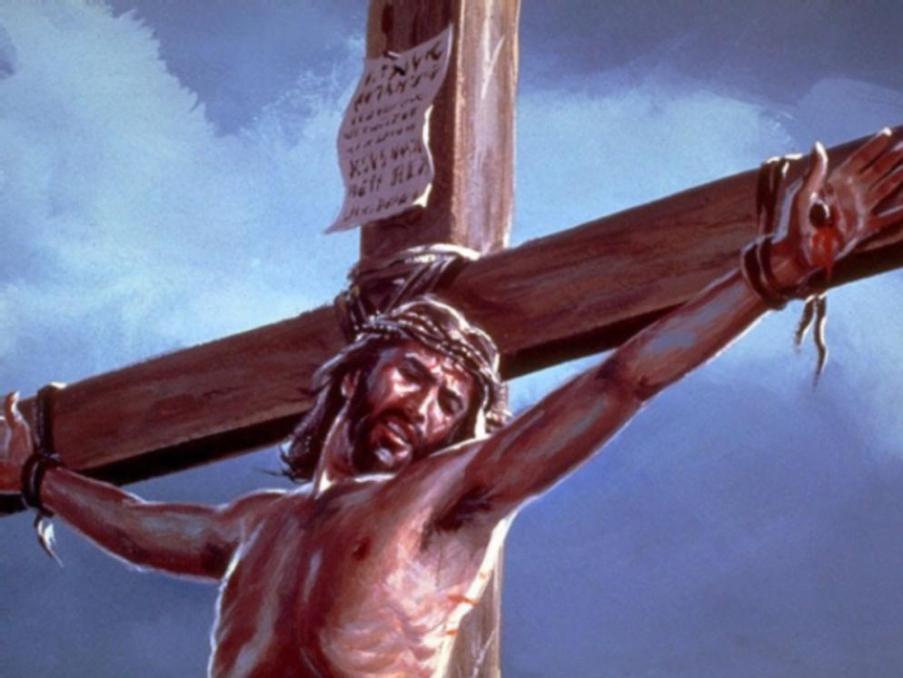
2 of 3 verses
Twanunulibwa twagulwa musaayi;
Kisuubizo eri buli-akiriza;
Omubi lukulwe amukiriza, Asonyiyibwa ebibi bye byonna

Slide 5
2 of 3 verses
CHORUS:
Tumutendereze, Ensi ewulire;
Tuyimbe tuyimbe, Ensi Esanyuke;
Mujj(e) eri kitaffe mu Mwana Yesu;
Aweebw(e) ekitiibwa yatununula.

Slide 6
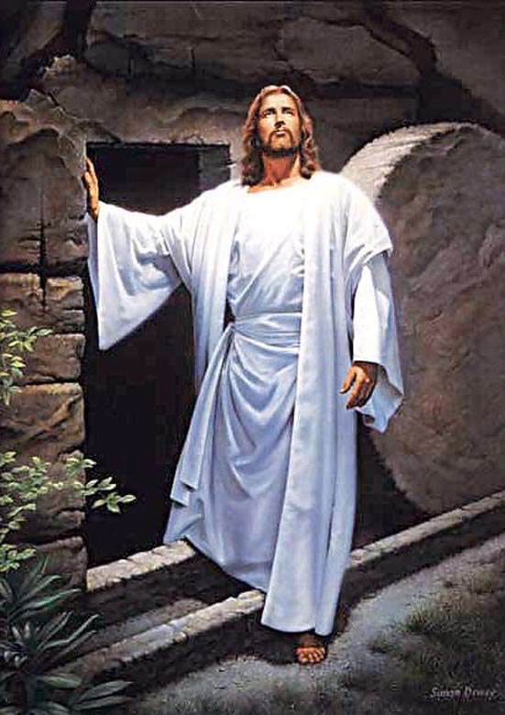
3 of 3 verses
Atuyigiriz(a) ebikulu bingi,
N’essanyu lingi lyatuwa mu Yesu;
Oyo Mutukuvu mugulumivu, Kiriba kisuffu nga tumulabye

Slide 7
3 of 3 verses
CHORUS:
Tumutendereze, Ensi ewulire;
Tuyimbe tuyimbe, Ensi Esanyuke;
Mujj(e) eri kitaffe mu Mwana Yesu;
Aweebw(e) ekitiibwa yatununula.

